Slide 1
UPPER SIXTH ARTS
GEOGRAPHY
Lesson 16: Carrying Capacity
Carrying Capacity
Notes:
Good morning, class, and welcome to our geography lesson. I am your geography teacher, Mr Kamdem. Today we are starting Lesson 16: Carrying Capacity.

Slide 2
CLASS INFO
Class, Chapter and Duration
Class | Upper Sixth Arts
Chapter | Module 4: Understanding and managing population dynamics across the world in general and Cameroon in particular
Duration | 2 periods (2 × 50 minutes)
Notes:
This lesson is for Upper Sixth Arts. It belongs to Module 4: Understanding and managing population dynamics across the world in general and Cameroon in particular. We shall need 2 periods to cover it.

Slide 3
IDENTIFICATION
Lesson Identification
Topic | Population Growth and Resources
Sub-topic | Population and Resource Relationships
Lesson | Lesson 16: Carrying Capacity
Notions / Concepts | Carrying capacity, overshoot, resource, technology, population-resource regime.
Syllabus focus | Meaning; ways of adjusting resources to carrying capacity; population-resource regimes.
Competence | Learners are able to explain carrying capacity and how societies adjust to it.
Notes:
Our topic is Population Growth and Resources, and the sub-topic is Population and Resource Relationships. The key notions we shall use today are: carrying capacity, overshoot, resource, technology, population-resource regime. At the end, you should be able to do this: learners are able to explain carrying capacity and how societies adjust to it.

Slide 4

HOMEWORK CORRECTION
Correction of the Homework
Question (Lesson 15: Types of Migration):
Make a table of push and pull factors for a migrant from your village to a town.
Notes:
Before we start the new lesson, let us correct the homework I gave you at the end of Lesson 15: Types of Migration. The question was: Make a table of push and pull factors for a migrant from your village to a town. Take out your exercise books.

Slide 5
HOMEWORK CORRECTION
Correction: Possible Answer
Push factors (village): poverty, lack of jobs, poor schools and hospitals, small farms. Pull factors (town): jobs, schools, hospitals, electricity, entertainment.
Notes:
Here is a good answer. Push factors (village): poverty, lack of jobs, poor schools and hospitals, small farms. Pull factors (town): jobs, schools, hospitals, electricity, entertainment. Compare it with your own answer and correct your work in red.

Slide 6
LESSON PLAN
Lesson Plan
Correction of the homework
Objectives and recall
Real-life situation and action to take
Learning activities
Board summary
Evaluation, remediation and homework
Notes:
Here is the plan of our lesson today. First, we shall correct the homework. Then we shall look at the objectives and recall what you already know. After that, we shall study a situation from real life and the action to take, and do the learning activities. Finally, we shall copy the board summary, do the evaluation and the remediation, and I will give you the homework.

Slide 7
OBJECTIVES
Objectives
By the end of this lesson, you should be able to:
Define carrying capacity.
Explain ways of raising carrying capacity.
Describe population-resource regimes.
Notes:
By the end of this lesson, you should be able to do three things. Number 1: define carrying capacity. Number 2: explain ways of raising carrying capacity. Number 3: describe population-resource regimes.

Slide 8
PREVIOUS KNOWLEDGE
Previous Knowledge
Population is growing fast in LEDCs.
Overgrazing damages land.
Notes:
Let us first remember what you already know. Population is growing fast in LEDCs. Overgrazing damages land. Keep this in mind, because we shall build on it today.

Slide 9
REAL-LIFE SITUATION
Situation in Real Life
In parts of the Far North, herds and families have increased, but the grass and water have not. After a dry year, cattle die and some families leave for the south.
Notes:
Listen carefully to this situation from real life. In parts of the Far North, herds and families have increased, but the grass and water have not. After a dry year, cattle die and some families leave for the south. Think about it, because I am going to ask you some questions.

Slide 10
REAL-LIFE SITUATION
Situation: Question 1
What is the problem in the situation?
Notes:
Question 1: What is the problem in the situation? Think for a moment, then raise your hand to answer.

Slide 11
REAL-LIFE SITUATION
Answer
The land cannot support all the people and animals.
Notes:
Good. The land cannot support all the people and animals.

Slide 12
REAL-LIFE SITUATION
Situation: Question 2
What is the limit called?
Notes:
Question 2: What is the limit called? Think for a moment, then raise your hand to answer.

Slide 13
REAL-LIFE SITUATION
Answer
The carrying capacity.
Notes:
Good. The carrying capacity.

Slide 14
REAL-LIFE SITUATION
Situation: Question 3
How can it be raised?
Notes:
Question 3: How can it be raised? Think for a moment, then raise your hand to answer.

Slide 15
REAL-LIFE SITUATION
Possible Answer
By better technology, like irrigation and improved pastures.
Notes:
Good. By better technology, like irrigation and improved pastures.

Slide 16
ACTION TO TAKE
Action to Take
Raise the carrying capacity of our land through sustainable techniques.
Notes:
From this situation, the action we are working towards in this lesson is the following: raise the carrying capacity of our land through sustainable techniques.

Slide 17
JUSTIFICATION
Justification of the Lesson
This lesson helps us to understand the limits of land and how to raise them.
Notes:
Why is this lesson important for you? This lesson helps us to understand the limits of land and how to raise them.

Slide 18
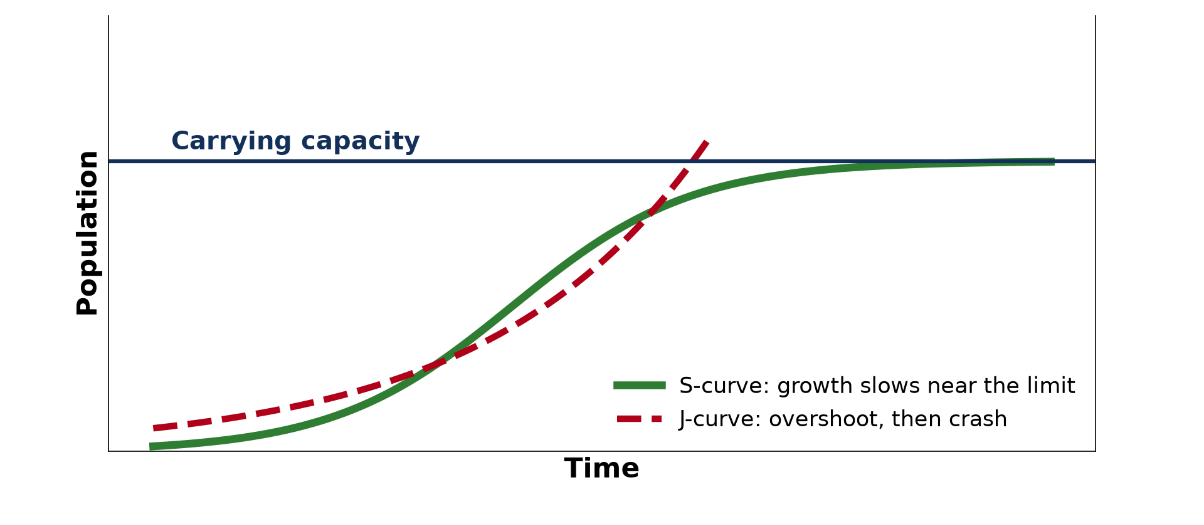
1. MEANING
Activity 1
Growth towards carrying capacity.
Notes:
Activity 1. Look carefully at this diagram: growth towards carrying capacity. Observe every detail before I ask the question.

Slide 19
1. MEANING
Activity 1: Question
What happens when a population overshoots its carrying capacity?
Notes:
Here is the question for Activity 1: What happens when a population overshoots its carrying capacity? Take one minute to think and write your answer in your rough notebook.

Slide 20
1. MEANING
Activity 1: Answer
Resources are damaged and the population crashes.
Notes:
Let us check the answer together. Resources are damaged and the population crashes.

Slide 21

1. MEANING
Activity 2
Cattle grazing.
Notes:
Activity 2. Look carefully at this picture: cattle grazing. Observe every detail before I ask the question.

Slide 22
1. MEANING
Activity 2: Question
What happens to pasture if there are too many cattle?
Notes:
Here is the question for Activity 2: What happens to pasture if there are too many cattle? Take one minute to think and write your answer in your rough notebook.

Slide 23
1. MEANING
Activity 2: Answer
It is overgrazed and the soil erodes.
Notes:
Let us check the answer together. It is overgrazed and the soil erodes.

Slide 24

2. ADJUSTING: TECHNOLOGY
Activity 3
Irrigated fields.
Notes:
Activity 3. Look carefully at this picture: irrigated fields. Observe every detail before I ask the question.

Slide 25
2. ADJUSTING: TECHNOLOGY
Activity 3: Question
How does irrigation raise carrying capacity?
Notes:
Here is the question for Activity 3: How does irrigation raise carrying capacity? Take one minute to think and write your answer in your rough notebook.

Slide 26
2. ADJUSTING: TECHNOLOGY
Activity 3: Answer
It allows more crops per year on the same land.
Notes:
Let us check the answer together. It allows more crops per year on the same land.

Slide 27
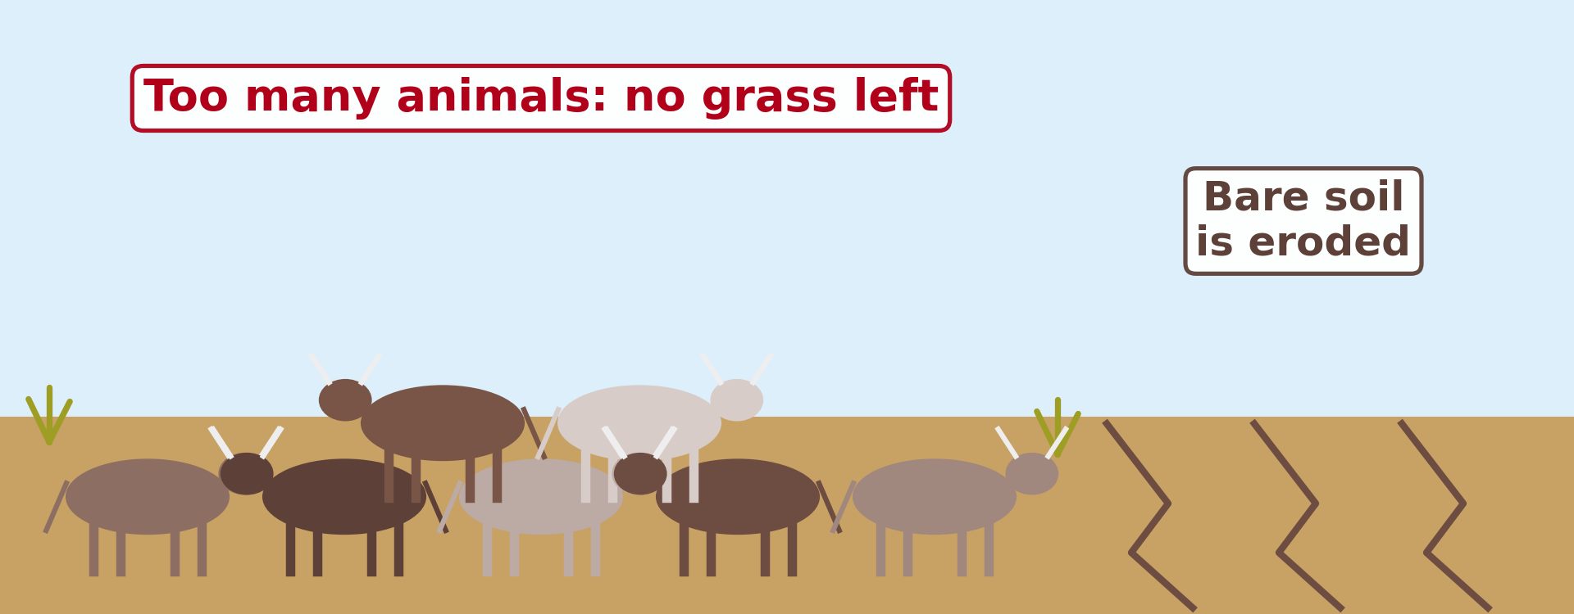
2. ADJUSTING: OTHER WAYS
Activity 4
Overgrazed land.
Notes:
Activity 4. Look carefully at this diagram: overgrazed land. Observe every detail before I ask the question.

Slide 28
2. ADJUSTING: OTHER WAYS
Activity 4: Question
Give two other ways to adjust to carrying capacity.
Notes:
Here is the question for Activity 4: Give two other ways to adjust to carrying capacity. Take one minute to think and write your answer in your rough notebook.

Slide 29
2. ADJUSTING: OTHER WAYS
Activity 4: Answer
Reduce herd size, migrate, or import food (also family planning).
Notes:
Let us check the answer together. Reduce herd size, migrate, or import food (also family planning).

Slide 30
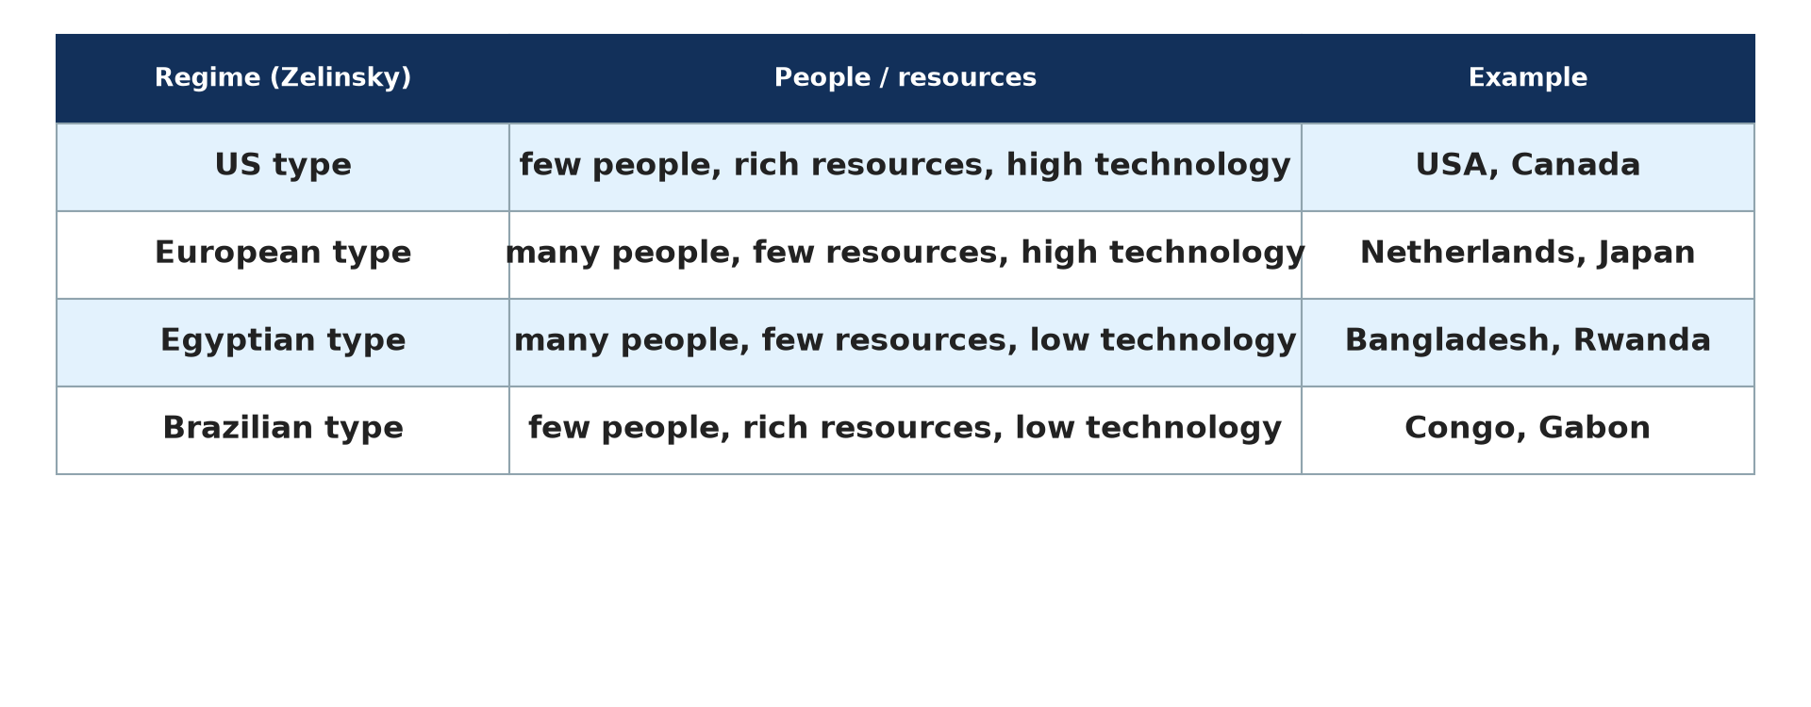
3. POPULATION–RESOURCES REGIMES
Activity 5
Population-resource regimes.
Notes:
Activity 5. Look carefully at this diagram: population-resource regimes. Observe every detail before I ask the question.

Slide 31
3. POPULATION–RESOURCES REGIMES
Activity 5: Question
Which regime has few people and rich resources but low technology?
Notes:
Here is the question for Activity 5: Which regime has few people and rich resources but low technology? Take one minute to think and write your answer in your rough notebook.

Slide 32
3. POPULATION–RESOURCES REGIMES
Activity 5: Answer
The Brazilian type (Congo, Gabon).
Notes:
Let us check the answer together. The Brazilian type (Congo, Gabon).

Slide 33
BOARD SUMMARY
Board Summary
Topic: Population Growth and Resources
Sub-topic: Population and Resource Relationships
Lesson 16: Carrying Capacity
Notes:
Now we are going to copy the board summary. Write the title and the headings neatly in your notebooks. I will give you enough time for each slide, so do not rush.

Slide 34
BOARD SUMMARY
1. Meaning of Carrying Capacity
Carrying capacity can be understood as follows:
Carrying capacity: It is the maximum number of people (or animals) that an area can support with its resources without damaging the environment.
Notes:
Let us copy Meaning of Carrying Capacity. Carrying capacity can be understood as follows. On this slide we have Carrying capacity. Write each point on a new line, with the key term first, and explain it in your own words when we revise. When you finish, we go to the next slide.

Slide 35
BOARD SUMMARY
1. Meaning of Carrying Capacity (continued)
Overshoot: When the population goes beyond the carrying capacity, resources are overused. Overgrazing, soil erosion and famine follow.
Notes:
We continue with Meaning of Carrying Capacity. On this slide we have Overshoot. Write each point on a new line, with the key term first, and explain it in your own words when we revise.

Slide 36
BOARD SUMMARY
1. Meaning of Carrying Capacity
Illustration: carrying capacity
Notes:
Now draw this illustration in your notebook: carrying capacity. Give it a title and label it clearly.

Slide 37
BOARD SUMMARY
2. Ways of Adjusting Resources to Carrying Capacity
People adjust to carrying capacity in the following ways:
Raising resources: Irrigation, fertilisers, improved seeds and new technology increase production. Irrigation schemes at Maga and Lagdo raise the capacity of the North.
Notes:
Let us copy Ways of Adjusting Resources to Carrying Capacity. People adjust to carrying capacity in the following ways. On this slide we have Raising resources. Write each point on a new line, with the key term first, and explain it in your own words when we revise. When you finish, we go to the next slide.

Slide 38
BOARD SUMMARY
2. Ways of Adjusting Resources to Carrying Capacity (continued)
Reducing demand: Family planning, migration and controlled grazing reduce pressure on land. People move to less crowded areas.
Trade and conservation: Importing food and protecting resources extend carrying capacity. Soil conservation keeps land productive.
Notes:
We continue with Ways of Adjusting Resources to Carrying Capacity. On this slide we have Reducing demand and Trade and conservation. Write each point on a new line, with the key term first, and explain it in your own words when we revise.

Slide 39
BOARD SUMMARY
3. Population–Resources Regimes
Zelinsky identified the following regimes:
U.S. type (technological source area): Few people, rich resources and high technology give high living standards. The USA and Australia are examples.
Notes:
Let us copy Population–Resources Regimes. Zelinsky identified the following regimes. On this slide we have U.S. type (technological source area). Write each point on a new line, with the key term first, and explain it in your own words when we revise. When you finish, we go to the next slide.

Slide 40
BOARD SUMMARY
3. Population–Resources Regimes (continued)
European and Egyptian types: In the European type, many people and limited resources are balanced by technology and trade. In the Egyptian type, many people and limited resources with low technology give poverty.
Notes:
We continue with Population–Resources Regimes. On this slide we have European and Egyptian types. Write each point on a new line, with the key term first, and explain it in your own words when we revise. When you finish, we go to the next slide.

Slide 41
BOARD SUMMARY
3. Population–Resources Regimes (continued)
Brazilian and Arctic-desert types: The Brazilian type has few people, rich resources but low technology. The Arctic-desert type has few people and poor resources.
Notes:
We continue with Population–Resources Regimes. On this slide we have Brazilian and Arctic-desert types. Write each point on a new line, with the key term first, and explain it in your own words when we revise.

Slide 42
BOARD SUMMARY
3. Population–Resources Regimes
Illustration: population–resources regimes
Notes:
Now draw this illustration in your notebook: population–resources regimes. Give it a title and label it clearly.

Slide 43
FORMATIVE EVALUATION
Evaluation 1
Define carrying capacity.
Notes:
Now let us check what you have understood. Question 1: Define carrying capacity. Answer in your exercise book.

Slide 44
FORMATIVE EVALUATION
Expected Answer
The largest population an area can support without damage.
Notes:
The expected answer is: the largest population an area can support without damage. If you got it right, well done.

Slide 45
FORMATIVE EVALUATION
Evaluation 2
Give two ways to raise carrying capacity.
Notes:
Now let us check what you have understood. Question 2: Give two ways to raise carrying capacity. Answer in your exercise book.

Slide 46
FORMATIVE EVALUATION
Expected Answer
Irrigation and fertiliser (also new crops, technology, trade).
Notes:
The expected answer is: irrigation and fertiliser (also new crops, technology, trade). If you got it right, well done.

Slide 47
REMEDIATION
Remediation
Fill in the blanks:
Going beyond the carrying capacity is ______.
Irrigation ______ carrying capacity.
Many people, few resources, low technology is the ______ type.
Notes:
For those who need more practice, fill in the blanks in your exercise book. The answers are: number 1, overshoot; number 2, raises; number 3, Egyptian.

Slide 48
HOMEWORK
Homework
Explain how carrying capacity could be raised in your area.
Notes:
For your homework: Explain how carrying capacity could be raised in your area. We shall correct it at the beginning of our next lesson.

Slide 49
NEXT LESSON
Next Lesson
Our next lesson will be on:
Lesson 17: Overpopulation, Underpopulation and Optimum Population
Notes:
Our next lesson will be on Lesson 17: Overpopulation, Underpopulation and Optimum Population. Thank you for your attention, and see you next time.

Slide 50
BILINGUAL GAME
Bilingual Game (Jeu Bilingue)
English | Français
Carrying capacity | La capacité de charge
Resource | La ressource
Technology | La technologie
Overgrazing | Le surpâturage
Famine | La famine
Trade | Le commerce
Notes:
Let us play the bilingual game. I say a word in English, and you give me the French word. Then we do the reverse.

Slide 51
LOGBOOK
Official Logbook (1/2)
Module / Topic | Population Growth and Resources
Lesson Title | Lesson 16: Carrying Capacity
Expected Learning Outcomes | Define carrying capacity. Explain ways of raising carrying capacity. Describe population-resource regimes.
Competence | Learners are able to explain carrying capacity and how societies adjust to it.
Notes:
I record this information in the official logbook of the class after the lesson.

Slide 52
LOGBOOK
Official Logbook (2/2)
Matter Taught | Meaning of Carrying Capacity; Ways of Adjusting Resources to Carrying Capacity; Population–Resources Regimes.
Evaluation | Formative evaluation and remediation exercise.
Homework | Explain how carrying capacity could be raised in your area.
Enrolment / Present / Absent | ____ / ____ / ____
Achievement | To be completed after the lesson.
Notes:
I complete the second page of the logbook: the matter taught, the evaluation, the homework and the attendance.

Slide 53
TEACHER'S NOTE
Teacher's Note
Timing: Homework correction, plan, objectives 8 min | Recall, situation, action 10 min | 5 activities 30 min | Board summary (copying) 30 min | Evaluation, remediation 10 min | Homework, next lesson 5 min | Logbook 7 min
Without the projector (Activity 1): draw the S and J curves.
Without the projector (Activity 2): describe dry pastures.
Without the projector (Activity 3): mention SEMRY and Lagdo.
Without the projector (Activity 4): list solutions.
Without the projector (Activity 5): copy the table.
Notes:
This slide is for me, the teacher: it gives the timing of the lesson and what to do if the projector is not available.

Slide 54
REFERENCES
References
National Geography Syllabus, MINESEC/IGE/IP-SS, 2019 — Module 4 (Population Geography).
Photo, Activity 2: “Fulani cattle breed of West Africa” by International Livestock Research Institute, CC BY-NC-SA 2.0, via Flickr (https://www.flickr.com/photos/7155605@N03/48125675226)
Photo, Activity 3: “Mid-West Agriculture” by Djof, CC BY-NC-SA 2.0, via Flickr (https://www.flickr.com/photos/10787942@N00/147222315)
Diagrams and animations: drawn for this lesson (Geography Department).
Notes:
These are the references and picture credits used to prepare this lesson.

